Slide 1
Privacy in 2014
They why, what and how of owning data
Notes:
Welcome everybody

Slide 2
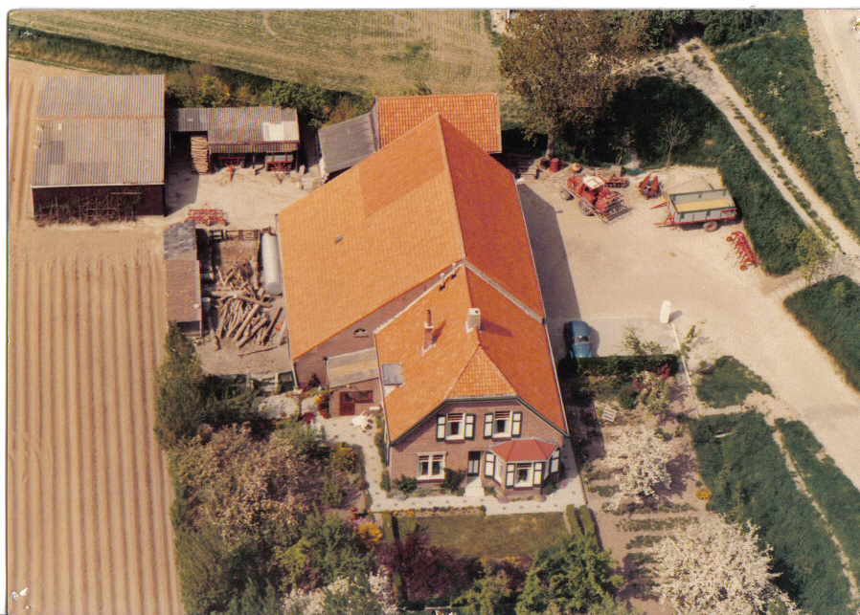
All mine
Notes:
South-West island, farmers
Buzzwords: lean, six sigma – business consulting
Open source hobby → work at SUSE
Now ownCloud
Bike through berlin (with good weather)
Enjoy company of wife and dog.

Slide 3
Agenda
The awesome cloud
The awful cloud
This thing called privacy
  “I have nothing to hide”
What we need
Getting back your data
Notes:
Good and bad of cloud
Value of privacy
And what you can do to protect it
40 minutes
Interrupt with questions

Slide 4
The awesome cloud
Notes:
Start with the awesomeness of the cloud. Do I need to tell you?

Slide 5
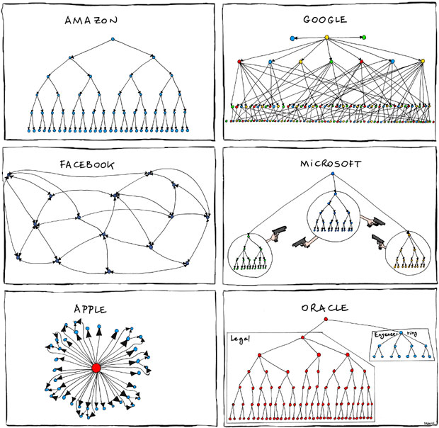
Great cloud services
Organizational charts
pic from xkcd.com
Notes:
Big boys have build great services.
Youtube and Gmail, Facebook, Dropbox, Tumbler and so on – we put our data online because it is great.

Slide 6
Awesomeness of the cloud
Accessible everywhere
Back up online
Easy sharing and collaboration
All free!!!
  (or super cheap)
Notes:
Android phone breaks – log in on new
Games online
Chatting, sharing pics or documents with others
Free or cheap!

Slide 7
The awful cloud
Notes:
Last point – price. How do we pay?
Bad side of the cloud.

Slide 8
Awfulness of the cloud
Where is my data?
Who can access my data?
How is my data used?
Notes:
Ask yourself these questions.

Slide 9
This thing called privacy
Notes:
Why it matters? Privacy, just that.

Slide 10
What do you have to hide?
You don't know!
You SHOULD have something!
Everybody needs privacy
Notes:
I have nothing to hide.
Well, you do. And you should. Besides, this isn't even the right argument to have.
Let's go over these three points

Slide 11
I - What do you have to hide?
So many rules and regulations...
Changing all the time!
Notes:
Let's talk about having things to hide.
27,000 pages of federal statues or 10,000 administrative regulations in US.
possessing a live lobster
Being smelly in Washington
Cop with access to everything can take everything
And that is today.
We Dutch remember: largest % of jewish deported due to great records.
Believe me: you have things to hide.
You just don't know what.

Slide 12
II - What you should hide
Perfect law enforcement = no change
  Slavery, cross-race marriage
  Gay marriage, sodomy laws
  Women rights
  Anything...
Notes:
There needs to be a healthy space in society for a little civil disobedience. This shouldn't be lost on the Dutch.
Our laws around euthanasia wouldn't have been here if people would not have rebelled.
Or think about drugs.
Often, things first change in society and THEN in laws. This is natural. Law makers are conservative and society progresses faster than they do.

Slide 13
III - It is a basic need
Control the impression you make on others
  Showers, Make-up, perfume, deodorant? Clothes?
All about 'saving face': who are you?
Notes:
Who needed a shrink?
How much do you care about how others see you?
Dating, soliciting for a job
Family, friends.
Facebook: everybody successful!
Picture of party, not hangover
Loving husband, funny guy, trusted son
Perfect politician – impossible, yes – corrupt

Slide 14
Who is safe?
"If privacy is outlawed,
only outlaws will have privacy."
- from the PGP manual
Notes:
You have, you should and you need something to hide.
Key: privacy eroded. Who gets hurt?
Not government
Not defense contractors, oil companies
Not big arms and drugs traffickers
Not well funded terrorists
You, me, grass-roots political organizations
Annoying journalist? Annoying local charity?
Not just 'evil government': In Mexico, doctor killed for 'bad tweets'.

Slide 15
Getting back your data
Notes:
So, what do we do?

Slide 16
Decentralization
Control:
  Location
  Access rights
Security
  Open Source
Ease of use
Notes:
Federation of data: back to the early days of internet
Decentralized with a communication protocol
Own server or
Bittorrent-like protocols
Open Source

Slide 17
Decentralization protects
Just like real life:
  Use a good lock
  Keep it out of sight
  Don't keep it in one place
Notes:
Real life analogy – translates online.
* Use encryption
* Keep out of sight
iPhone: iCloud. Android: Google Drive.
* Not in one place
Google, Apple security super.
But too interesting for governments to demand, criminals to steal, companies to buy
Much value is in 'big data analysis': correlating, relating. Credit card details – one isn't much, 10K is interesting.
Millions of separate vaults: less secure each, but less interesting.
Think of real neighborhood!

Slide 18
Decentralization protects
"We are all vulnerable to everyone because the NSA wanted us to be vulnerable to them."
- Bruce Schneier
Notes:
One note, because it came up AGAIN. Keeps coming.
Police should have a back door.
No, they should NOT: decrease security for all.
Self-fulfilling prophecy: it is like suggesting to not lock our doors so that if a burglary is in progress the feds can more easily enter our house.
We have ONE infrastructure. There is no world where the US gets to spy but the Chinese can't.
We are secure, or vulnerable.
Greece: phone back doors used by criminals
So backdoors are a BAD IDEA.
Balance – 919 in 1994 vs 4.2 million in Berlin

Slide 19
Take back your data
Notes:
You should be convinced now:
Cloud is awesome
But endangers privacy
And privacy matters
You know what you need: something you OWN.

Slide 20
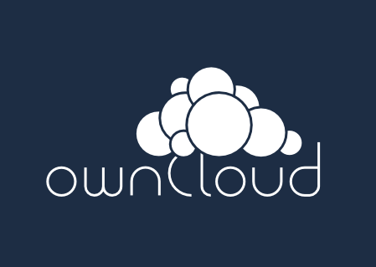
Introducing ownCloud
Sync and share
Open Source
Easy to use
Easy to install
Easy to extend
>1.8 mln users
Notes:
So, here's one such solution: ownCloud
Core: sync and share data
Ticks more boxes
Including what we discussed earlier

Slide 21


Sync and Share
Notes:
Cross-platform
Win/Lin/Mac desktop
Android, iOS, firefox and Jolla
third party applications

Slide 22
Sync and Share
Multi-platform
External Storage
  FTP, NFS, WebDAV, dropbox, S3, …
  Encryption
  Versioning
Sharing
  Public links, passwords, expiring, upload rights
Server to server sharing
Notes:
External Storage
* FTP, NFS, WebDAV, dropbox, S3, …
* Encryption
* Versioning
Sharing
Friends took pictures at your wedding?
Send them a public link, expiring in 2 monhts, protected with a password for uploading files!
Server to server sharing
3 German universities: 500K students, one cloud.
Federation and decentralization!

Slide 23
Easy to use
Easy to deploy: LAMP
Easy to hack on or inspect: PHP, JS, CSS
All-platform access
Notes:
blabla

Slide 24
Extensible
OwnCloud Apps
Notes:
ownCloud is a platform you can build apps on
Over 200 available
Get some examples later

Slide 25
Yours
Open Source
Millions of users
Since 2010
  500+ contributors, 300 in last year
  github.com/owncloud
  ownCloud Inc. for enterprise
Notes:
Most central point: YOU OWN IT.
Fully open
Development on github
AGPL
Etc.
ownCloud Inc offers Enterprise edition with a limited subset of apps which are supported
And set integration tools with proprietary enterprise tools like shibboleth, Oracle Databases and Microsoft Sharepoint.

Slide 26
Screenshot time

Slide 27
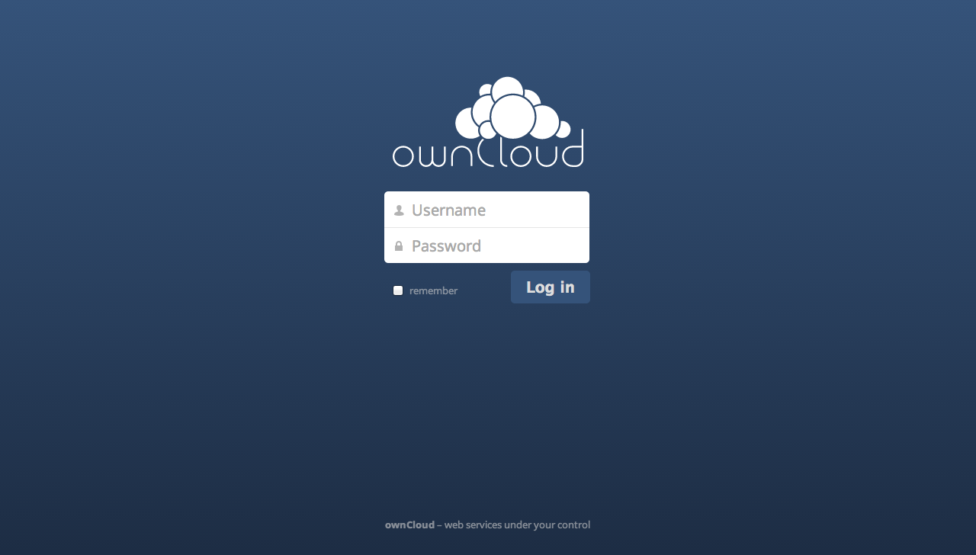
Welcome!

Slide 28
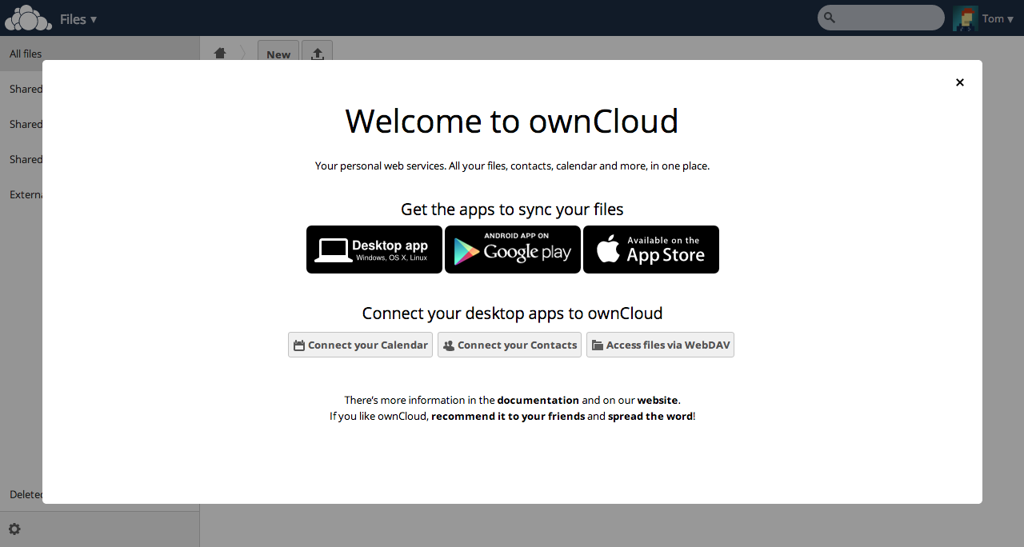
First run screen

Slide 29
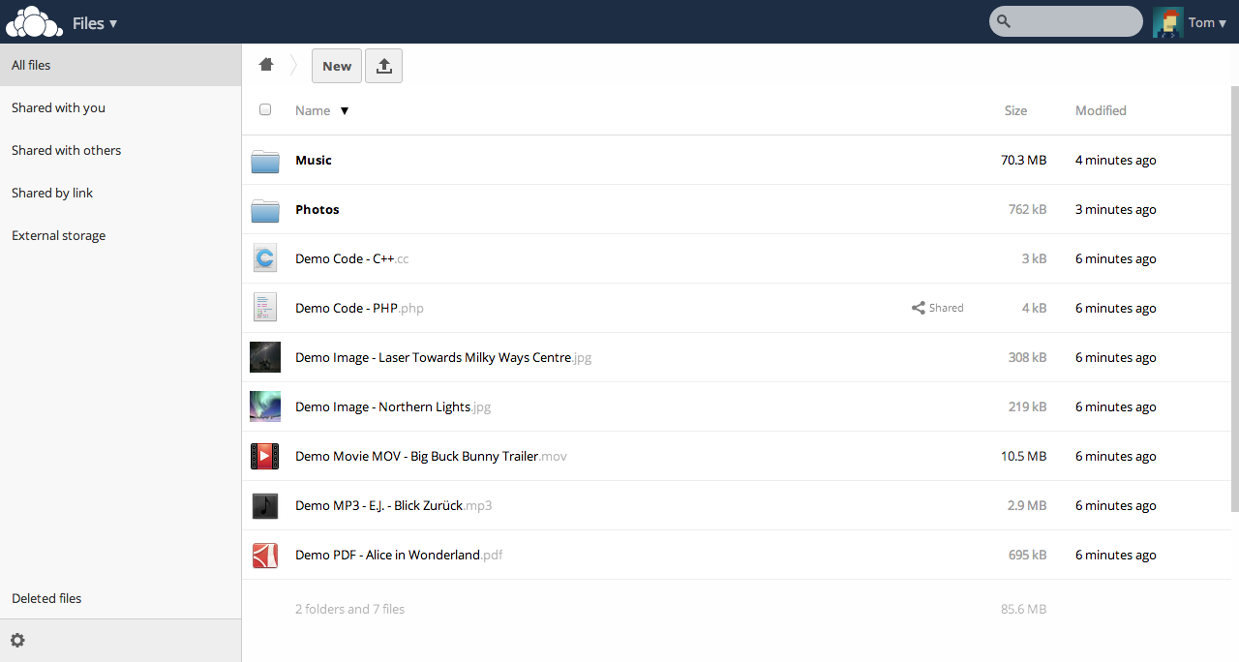
Files view

Slide 30
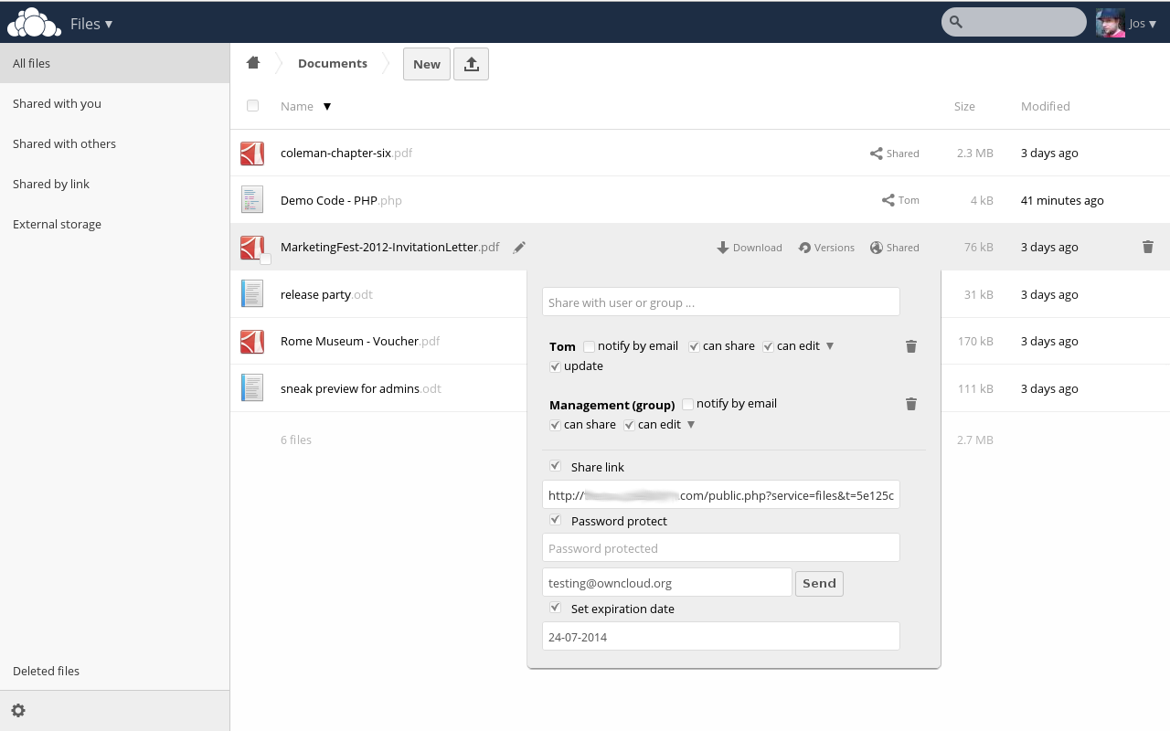
Sharing 1

Slide 31
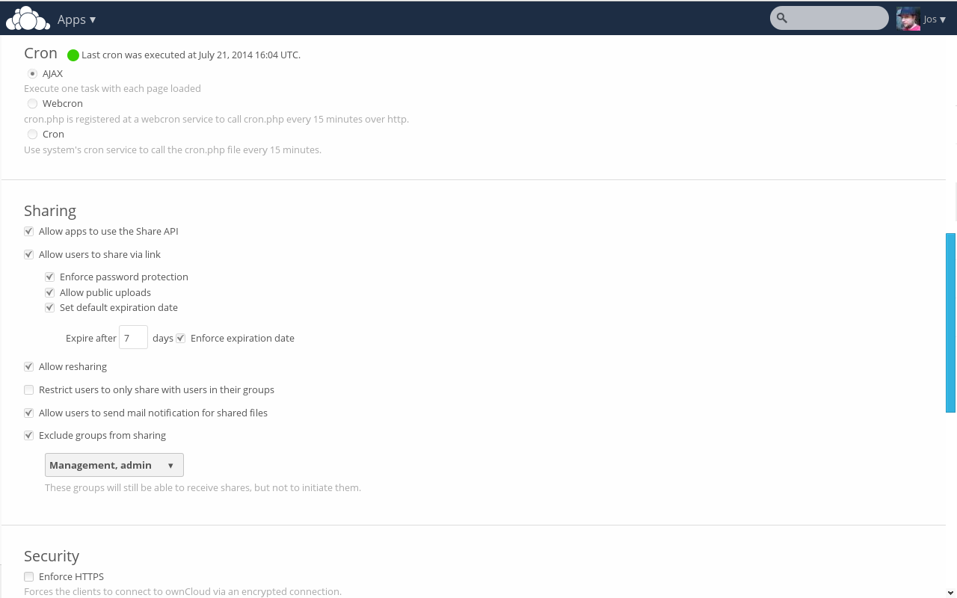
Sharing 2

Slide 32
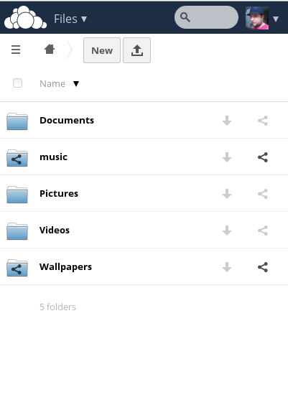
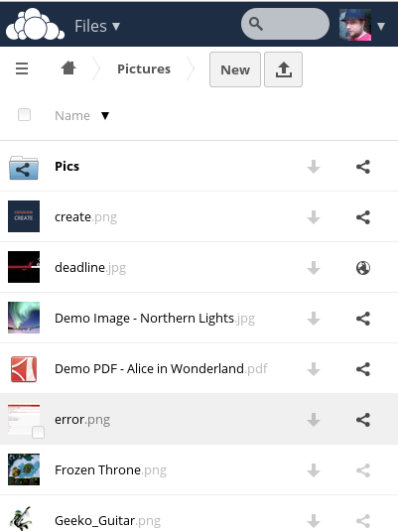
Mobile UI

Slide 33
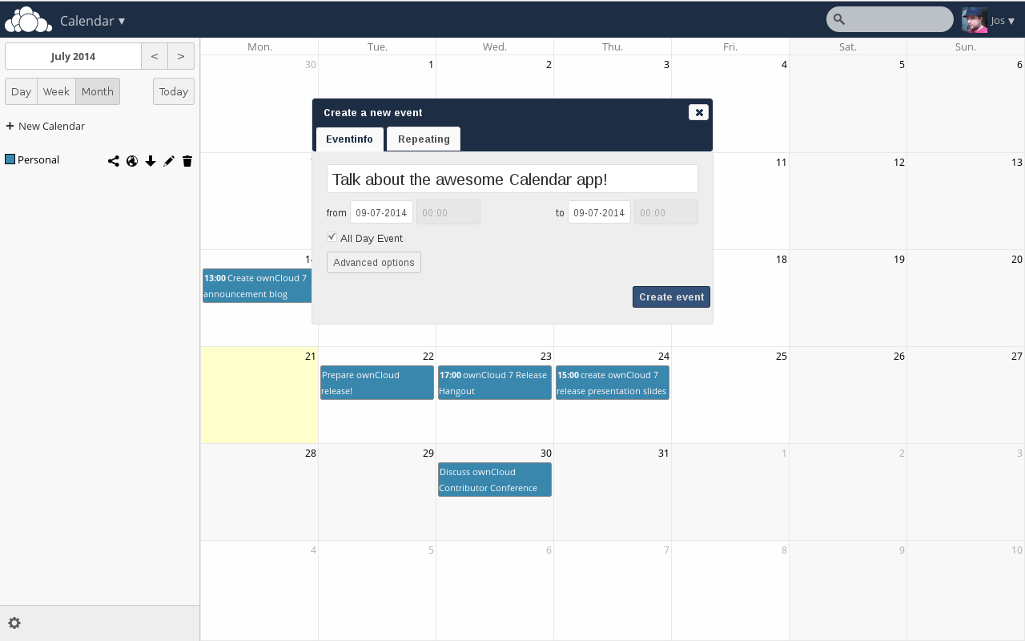
Calendar

Slide 34
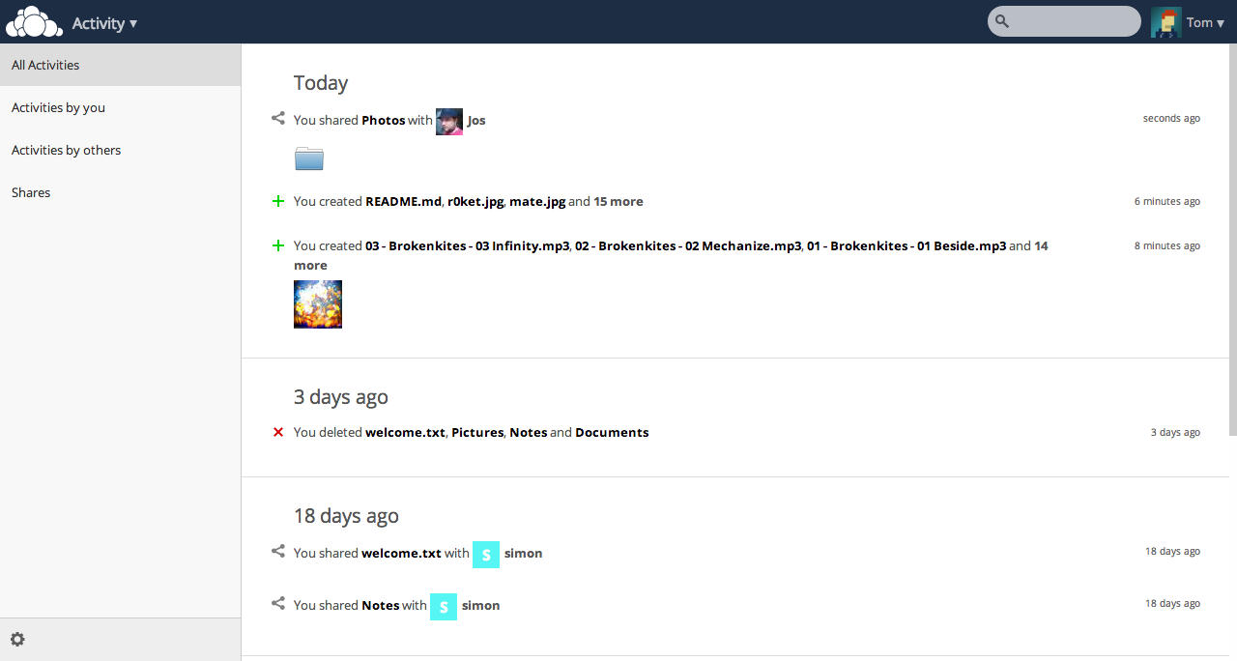
Activity 1

Slide 35
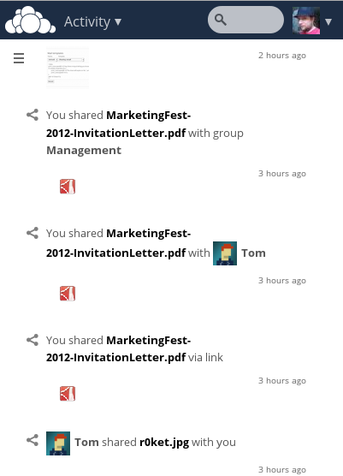
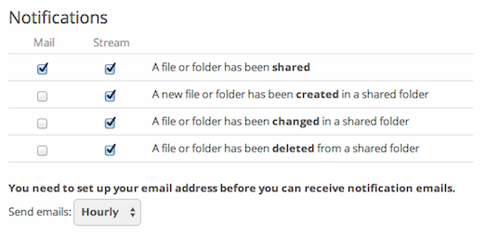
Activity 2

Slide 36
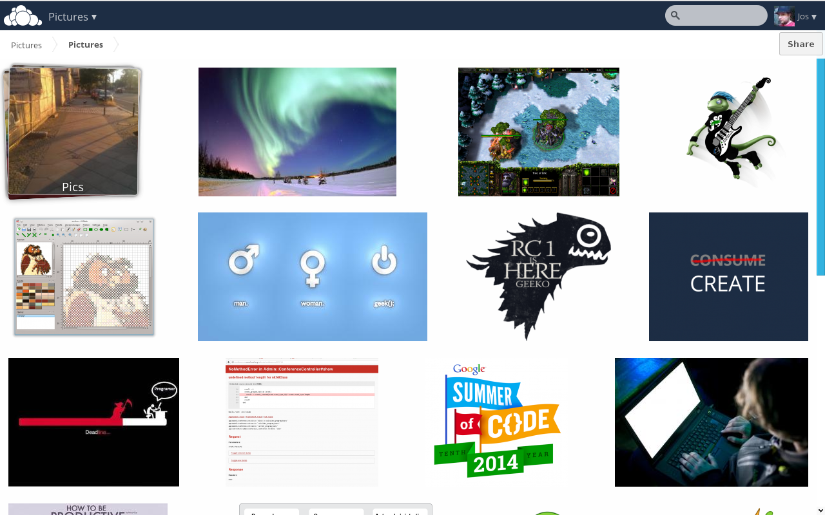
Pictures

Slide 37
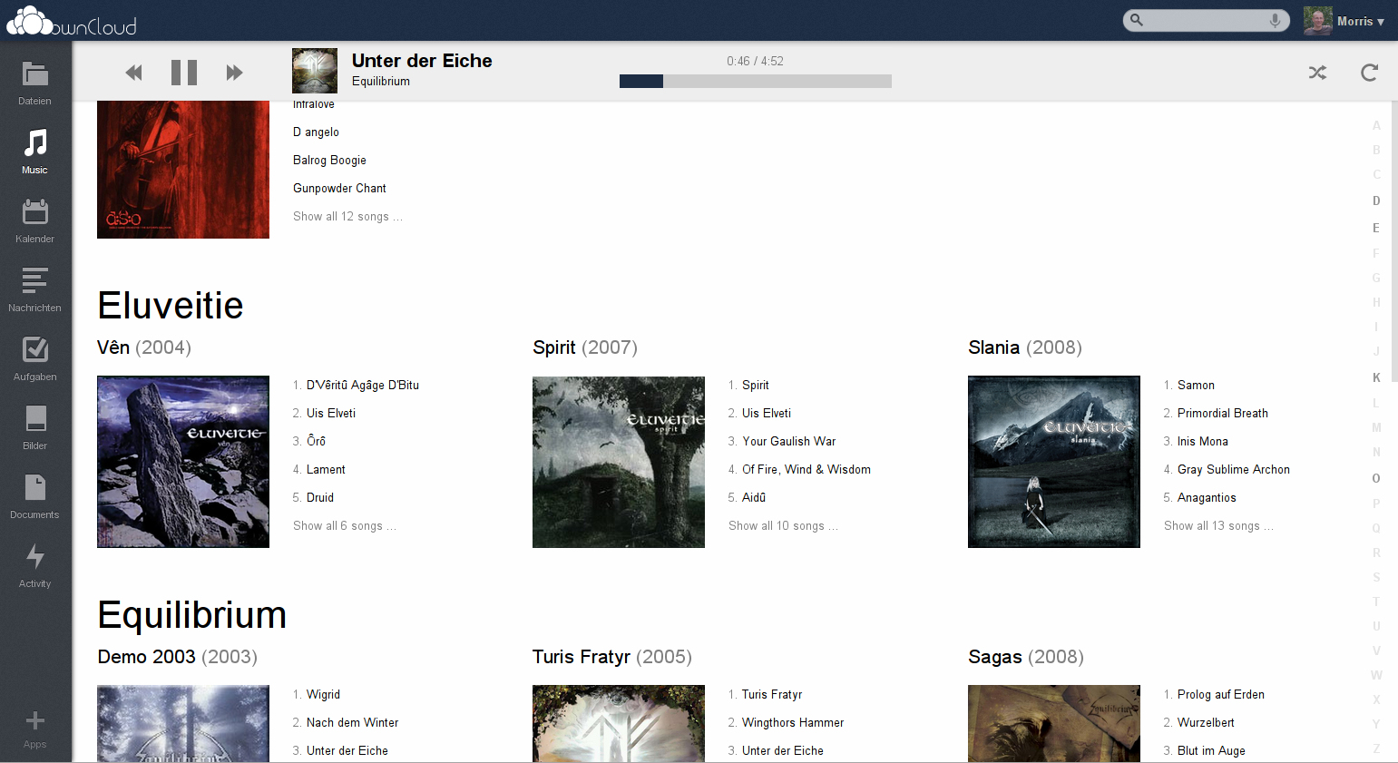
Music

Slide 38
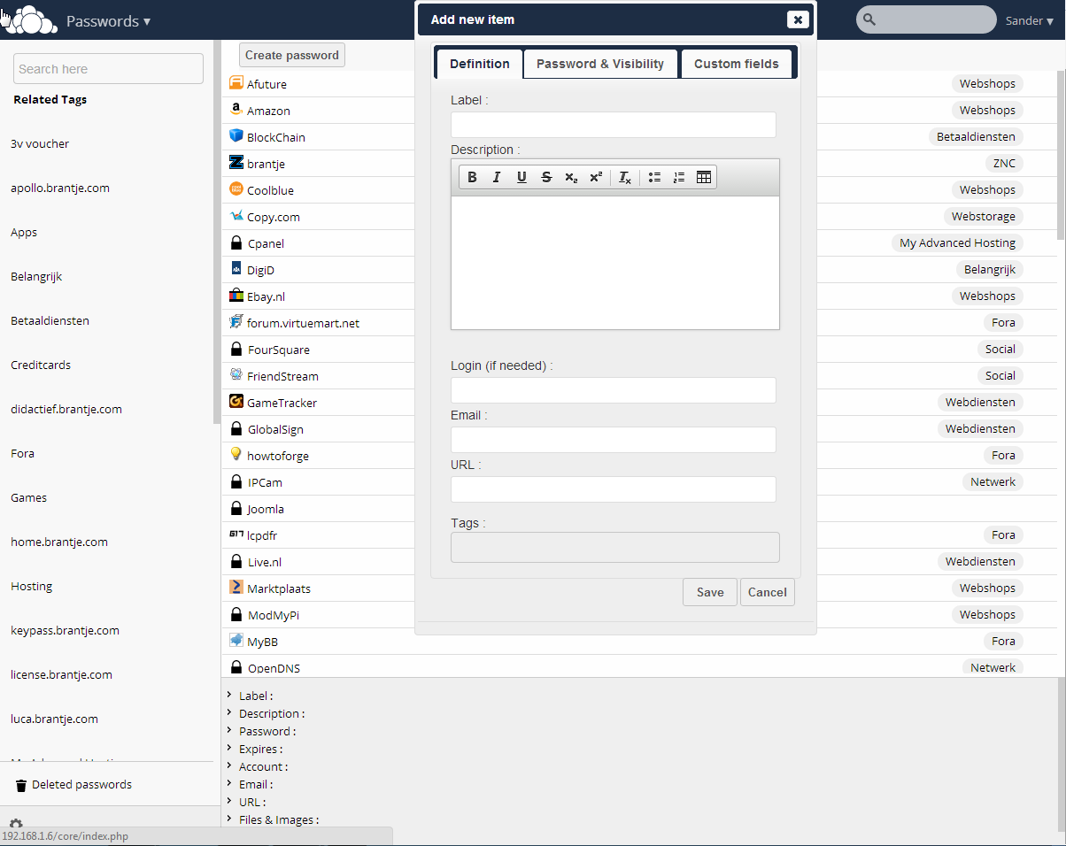
passman

Slide 39
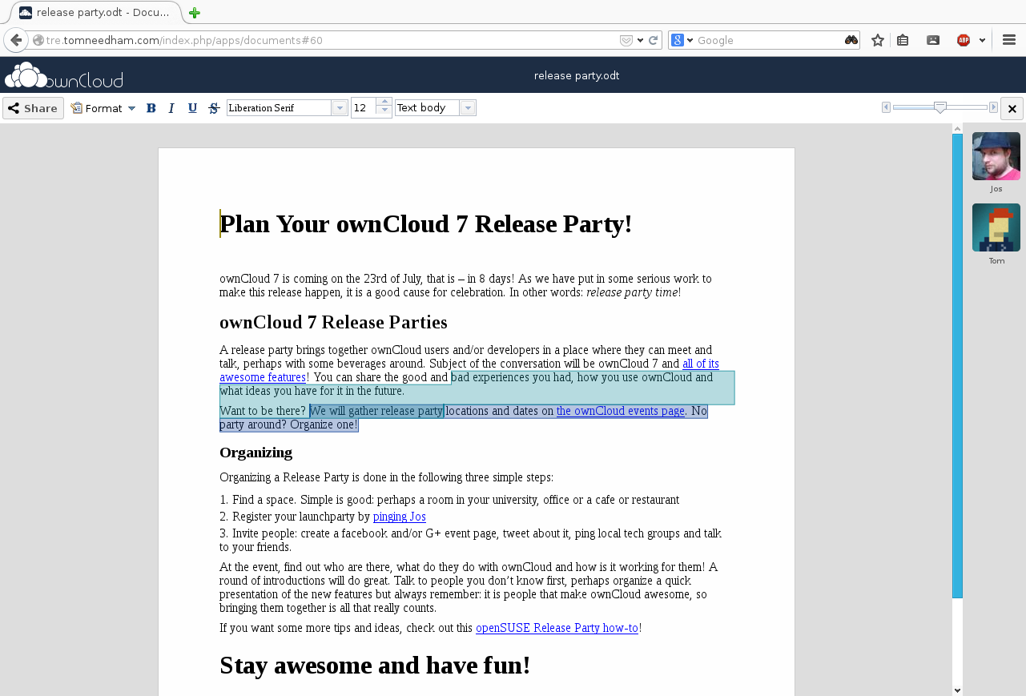
Documents

Slide 40
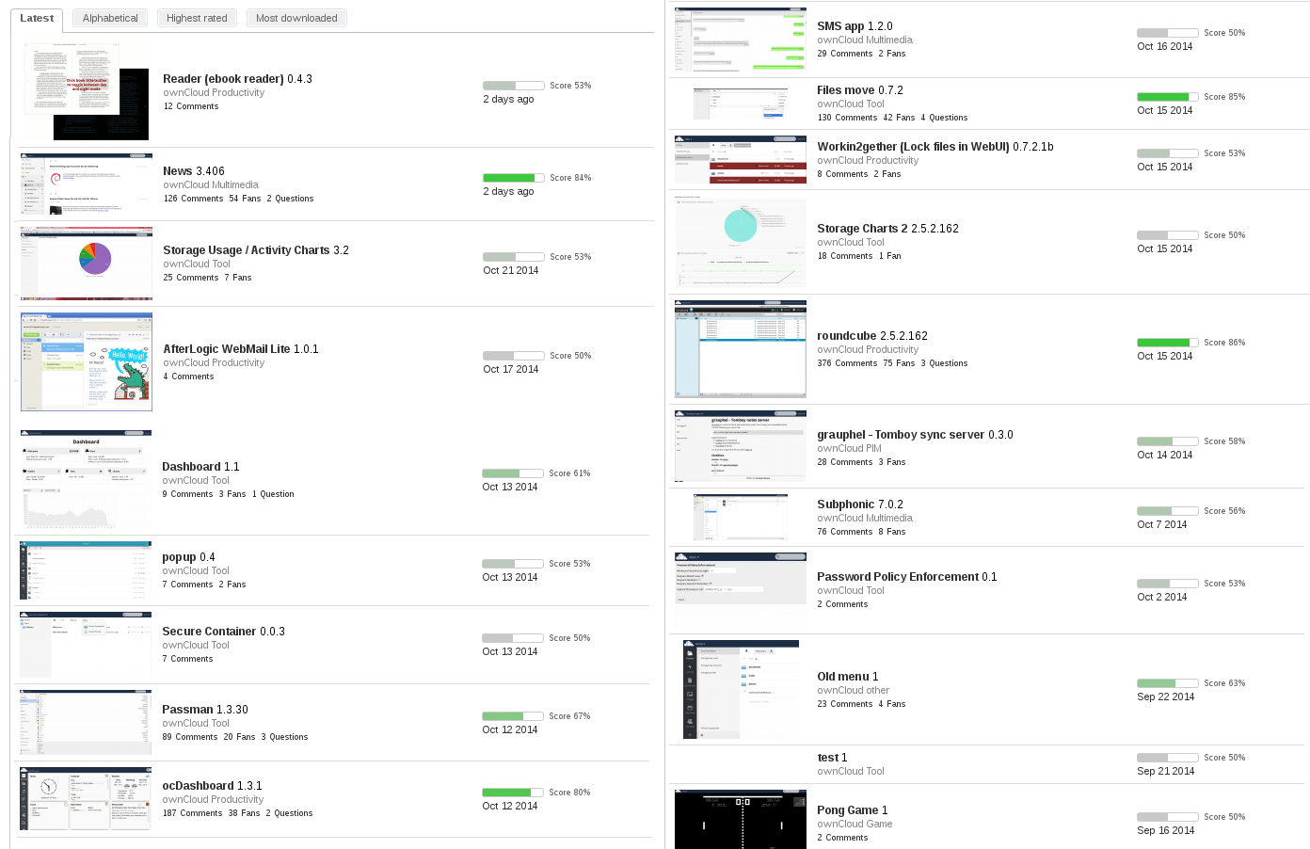
Almost 200 apps

Slide 41
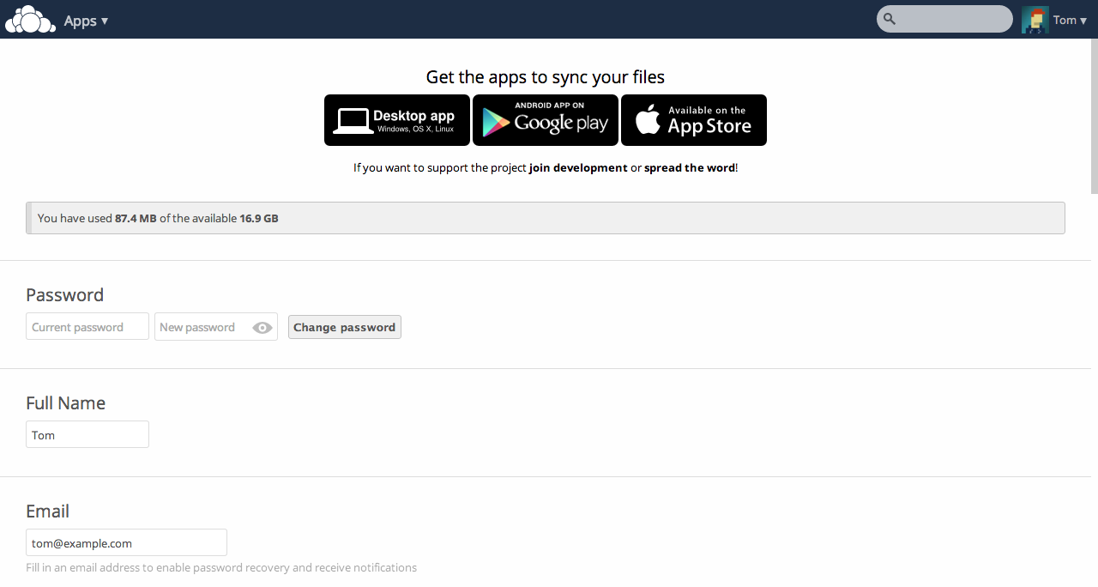
Personal settings

Slide 42
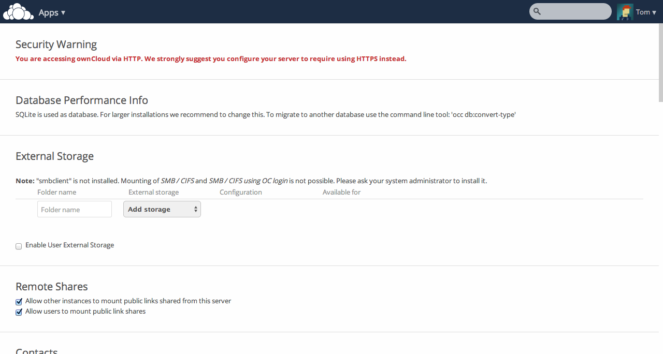
Admin settings

Slide 43
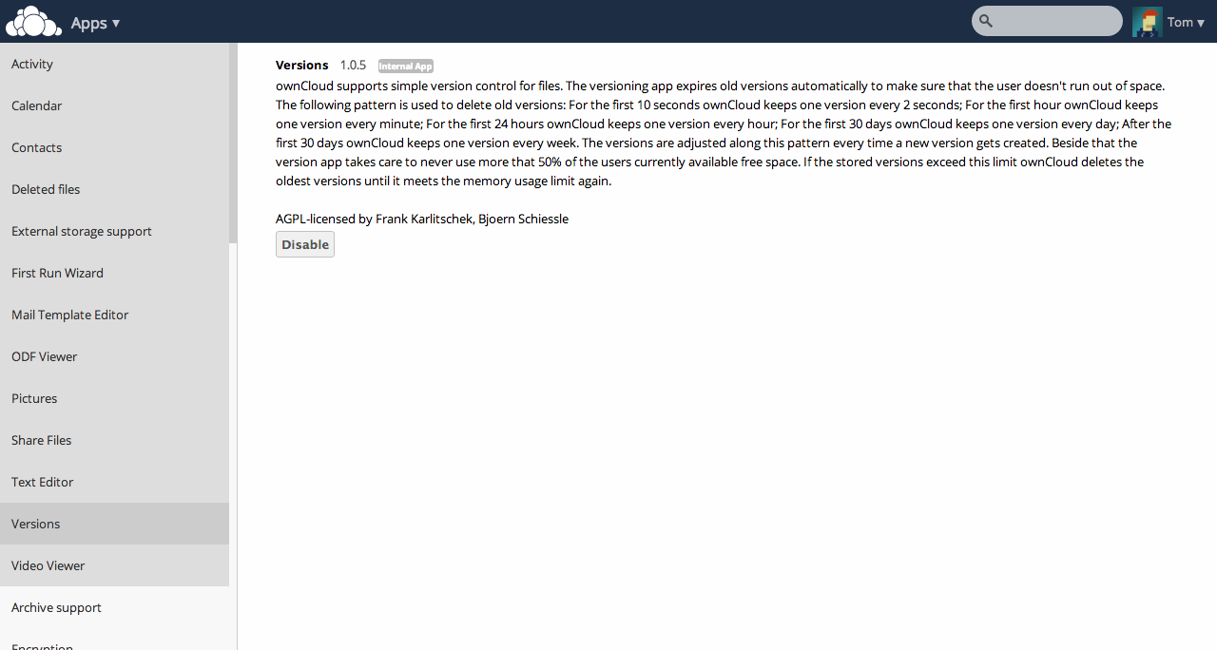
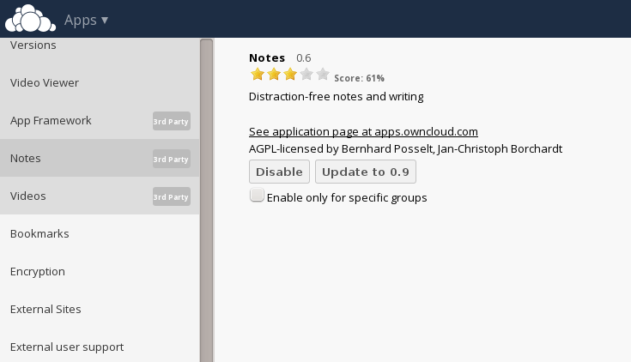
App management
Notes:
Mention automatic download, security

Slide 44
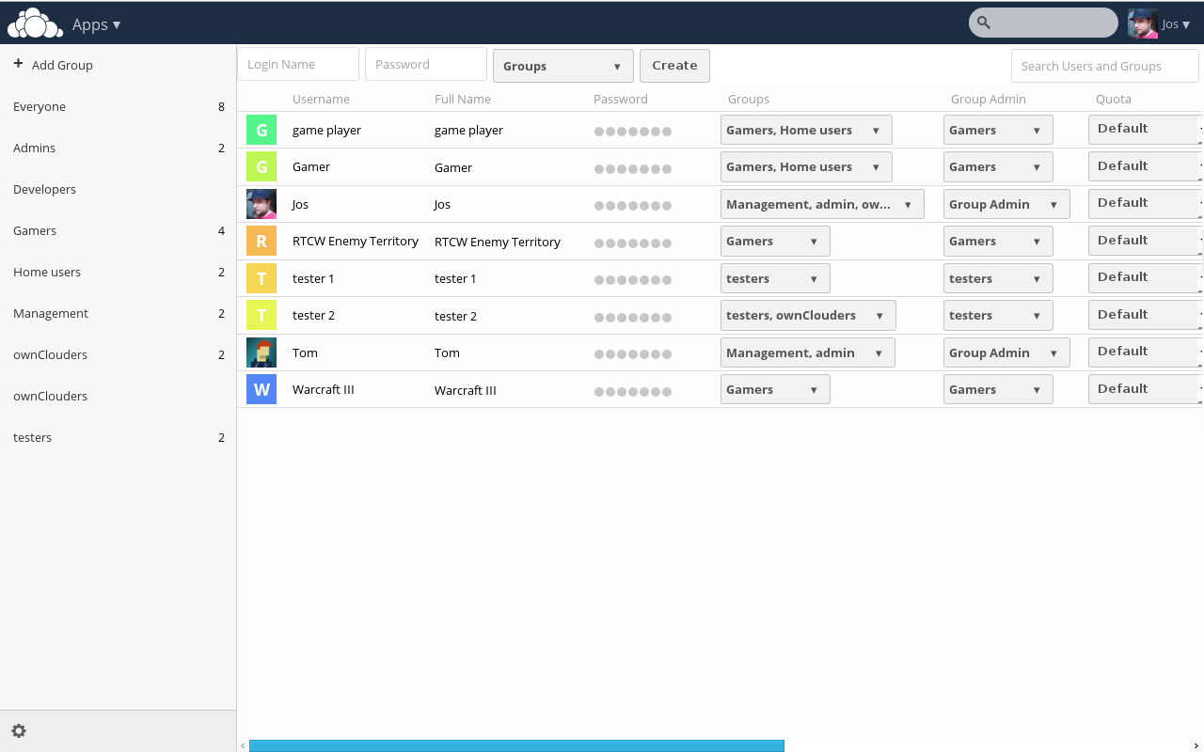
User Management
Notes:
LDAP supported. If you want to integrate with Shiboleth and other proprietary systems, you want the Enterprise Edition.

Slide 45
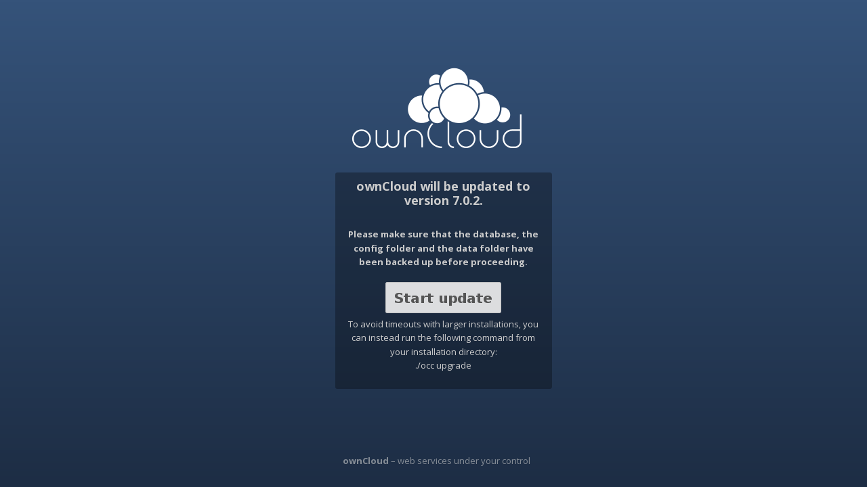
Upgrade

Slide 46
Get it
owncloud.org
owncloud.org/install
demo.owncloud.org
owncloud.org/contribute
doc.owncloud.org
owncloud.com

Slide 47
That's it!

